Slide 1
A Search Procedure for Hamilton Paths and Circuits
Frank Rubin
JACM, Vol. 21, No. 4, pp. 576-580, Oct. 1974

Slide 2
Abstract
A search procedure is given which will determine
whether Hamilton paths or circuits exist in a given
graph, and will find one or all of them. A combined
procedure is given for both directed and undirected
graphs. The search consists of creating partial paths
and making deductions which determine whether
each partial path is a section of any Hamilton path
whatever, and which direct the extension of the
partial paths.

Slide 3
The Search Procedure
S1. Select any single node as the initial path.
S2. Test the path for admissibility.
S3. If the path so far is admissible, list the successors of the last node chosen, and extend the path to the first of these. Repeat step S2.
S4. If the path so far is inadmissible, delete the last node chosen and choose the next listed successor of the preceding node. Repeat S2.

Slide 4
The Search Procedure
S5. If all extensions from a given node have been shown inadmissible, repeat step S4.
S6. If all extensions from the initial node have been shown inadmissible then no circuit exists.
S7. If a successor of the last node is the origin, a Hamilton circuit is formed; if all Hamilton circuits are required, then list the circuit found, mark the partial path inadmissible, and repeat step S4.

Slide 5
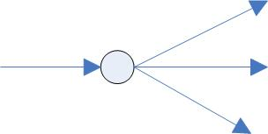
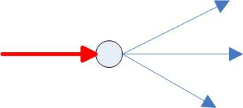


Deductions
Required edge rules
  R1 : 假如進來或出去只有一條邊, 就一定要選那條
  R2 : 假如只有兩條鄰邊, 兩條都一定要選

Slide 6


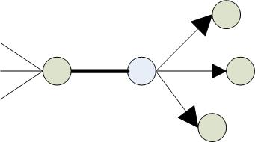
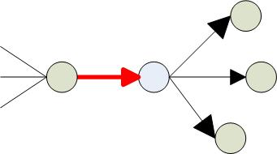
Deductions(con.)
Direction assignment rules
  A1 : 有一條必須的邊是進來(出去)的, 其他還沒有定方向的鄰邊都把方向設成出去(進來)
  A2 : 假如有一條必須的無方向邊, 且所有其他的鄰邊都是離開(進入), 就把這條必須的邊設成進入(離開)

Slide 7
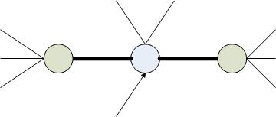
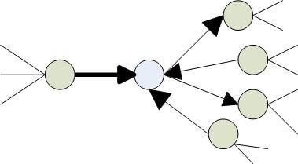
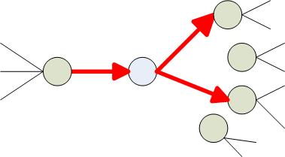
Deductions (con.)
Deleted edge rules
  D1 : 假如一個點有兩條必須鄰邊, 其他邊都可以砍掉
  D2 : 假如有一條必須的邊進入(離開), 其他進入 (離開)的邊都可以砍掉

Slide 8
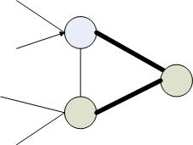
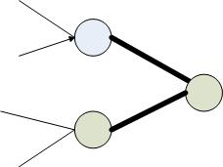


Deductions (con.)
  D3 : 假如有一些邊會和必須的邊形成close circuit , 就把那些邊砍掉, 除非這一圈就是hamilton circui
Failure or termination rules
  F1 : 有一個點都沒有邊相連
  F2 : 有一個點只剩一條鄰邊

Slide 9
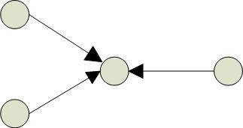

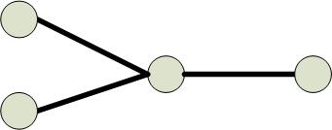
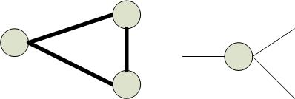
Deductions (con.)
  F3 : 有一個點沒有進入(離開)的邊
  F4 : 有一個點有兩條必須的邊進去(離開)
  F5 : 有一個點有三條必須的鄰邊
  F6 : 某一些必須的邊形成不是hamilton circuit的一圈

Slide 10
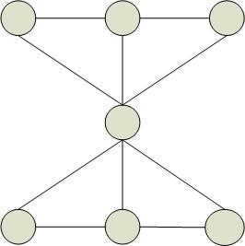
Deductions (con.)
  F7 : 對任何不在partial path 中的點 , 沒有被從partial
  path中的最後一點出發的邊連接
  F8 : 對任何不在partial path 中的點 , 沒有邊連到partial path中的第一點
  F9 : 若圖為1-connected

Slide 11
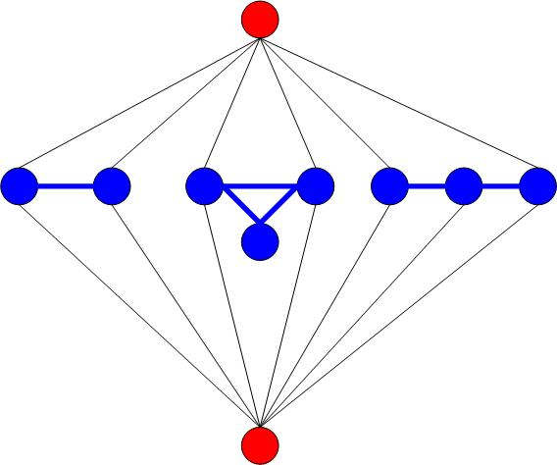
Decomposition and Reduction
A graph is called k-connected if the removal of some set of k nodes and their incident arcs leaves the graph disconnected, but no set of k - 1 nodes disconnects the graph.
k-articulation nodes
interior k-components
exterior k-component

Slide 12
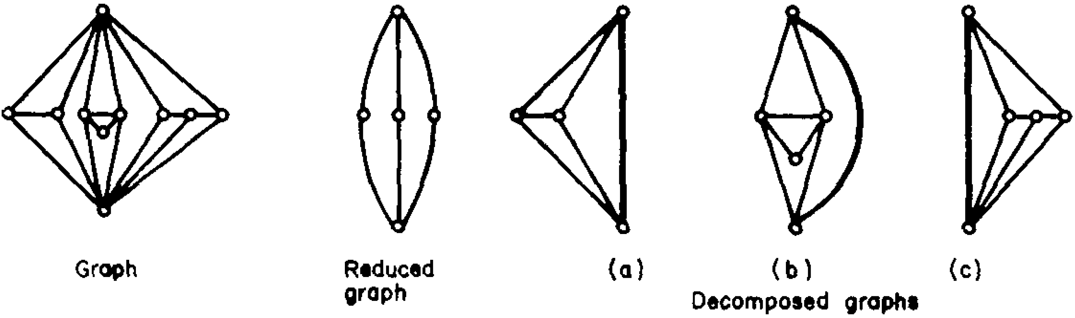
Decomposition and Reduction
When k > 1 the graph may be reduced by replacing each interior k-component by a canonical reduced form. The reduced graph is solved; then each component is solved.

Slide 13
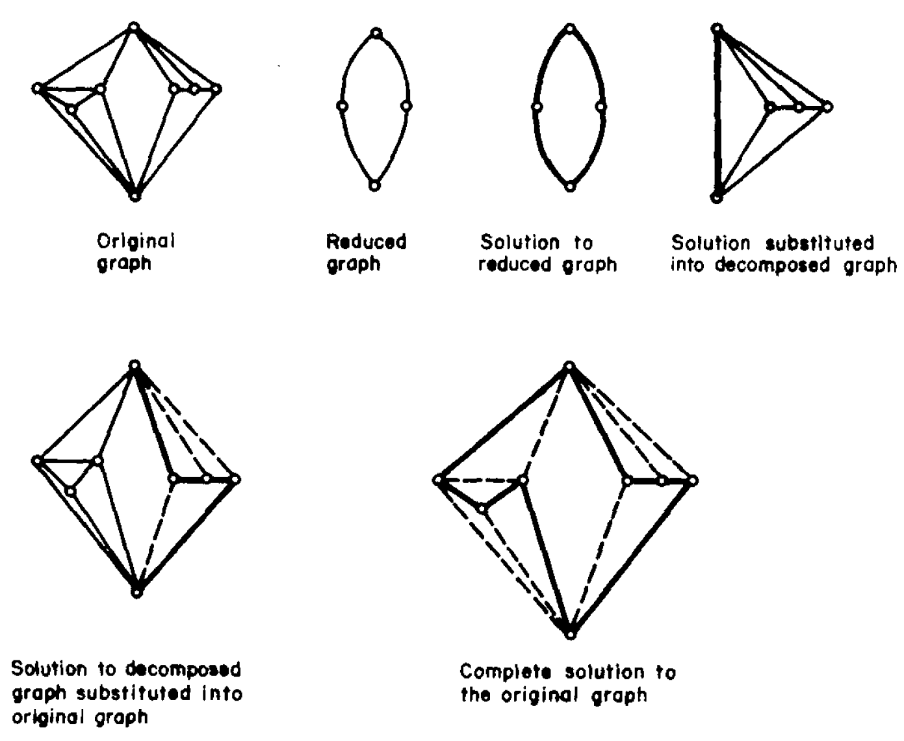
Decomposition and Reduction

